Slide 1




4th International Conference on Family Planning (ICFP) Nusa Dua, Bali 9-12 November 2015

Slide 2
Outline
Background
Three last conferences
General Information on the 4th IFCP
Committees
Progress

Slide 3
1. Background
ICFP is a biannual conference in the filed of family planning.
ICFP is:
A strategic event to strengthen the global commitment on FP programs;
A strategic event to obtain information, learning and knowledge sharing on global FP programs.
In the 3rd ICFP, in Addis Ababa, Ethiopia, Indonesia was designated to host the 4th ICFP in 2015
It is reconfirmed with a Memorandum of Collaboration between BKKBN and John Hopkins University Bloomberg School of Public Health, signed in Bali, 14 August 2014;

Slide 4
2. Three Last Conferences
ICFP | Number of participants | Theme
1st in Kampala, Uganda, Nov 15-18, 2009 | 1,300 (59 countries) | Research and Best Practices
2nd in Dakar, Senegal, Nov 29 – Dec 2, 2011 | 2,200 (87 countries) | Research and Best Practices
3rd in Addis Ababa, Ethiopia, Nov 12-15, 2013 | 3,000 (80 countries) | Full Access, Full Choice

Slide 5
3. Information on the 4th ICFP
Information | Remarks
Date | 9-12 November 2015
Host | BKKBN dan Gates Institute
Venue | Bali Nusa Dua Convention Center (BNDCC)
Theme | Global commitment, Local Action
Participants | 3,000 – 3,500 Policy makers, researchers, experts, program managers, local and international NGOs, donors, youth, faith-based organization, private and development partners.

Slide 6
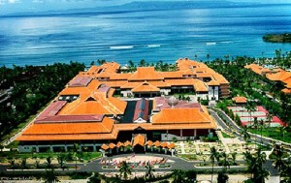
BNDCC

Slide 7
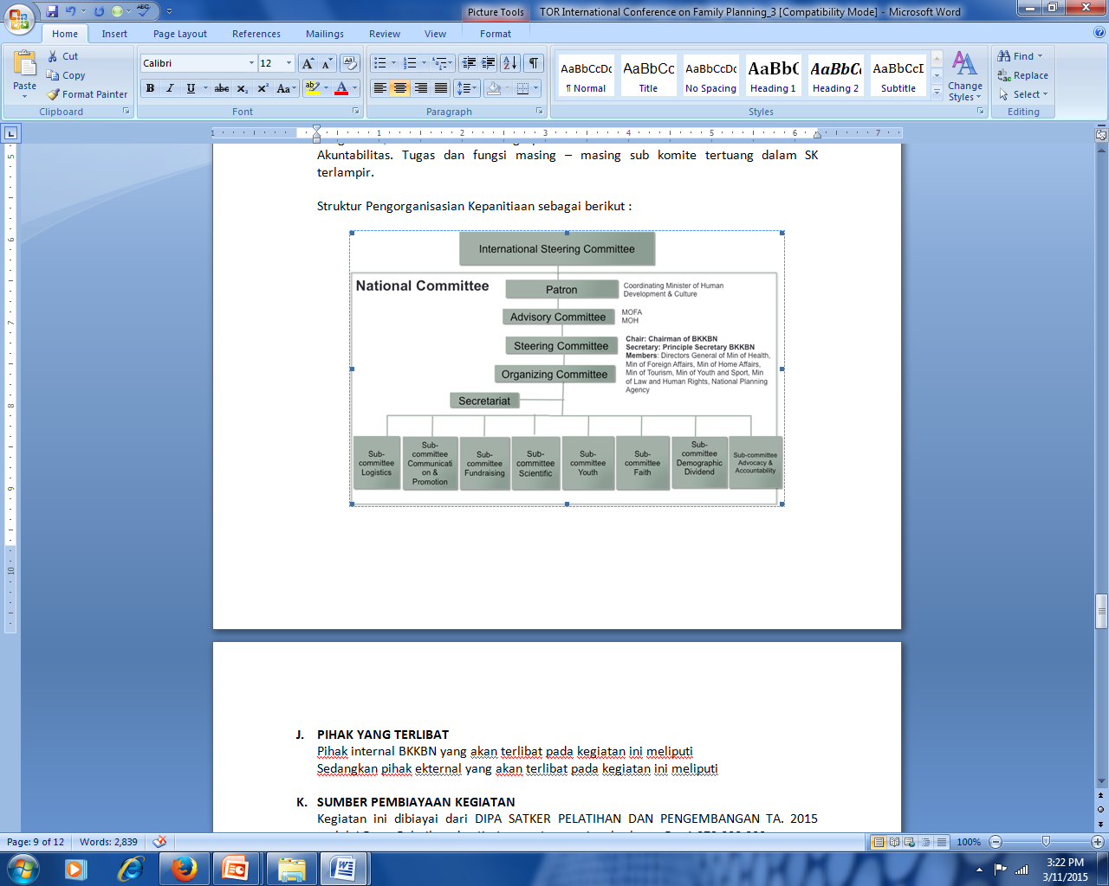
4. Committees

Slide 8
Coordination Mechanism
Juliana
GHS
PRB
Juliana
Amy Tsui
Gates Institute
Dr. Siswanto
jzuccaro@jhu.edu
jzuccaro@jhu.edu
jzuccaro@jhu.edu
jzuccaro@jhu.edu
Sub-committe for Logistic and Security
Sub-committe for Communication, National Media Promotion and Documentation
Sub-committee for Fundraising /Finance
Sub-committee for Scientific
Head of General Bureau, BKKBN
Head of Law, Organization and Public Relation Bureau, BKKBN
Head of Planning Bureau, BKKBN
Prof. dr. Siswanto Agus Wilopo, SU., M.Sc., ScD.

Slide 9
Bob Blum
Kate Baye
JHSPH
IYAFP
Mona Bormet
CCIH
Peter Munene
F2A
Emma Rachmawati
Jason Bremner
Amy Tsui
Benoit Kalasa
Beth Fredrick
cbaye1@jhmi.edu
mona.bormet@ccih.org
smegquier@prb.org
bfredri1@jhu.edu
Sub-committee for Youth
Sub-committee for Faith
Sub-committee for Demographic Dividend
Sub-committee for Advocacy and Accountability
Muhammad Najib Azca, MA, Academic, UGM
DR. Hj. Emma Rahmawati, M.Kes (Muhammadiyah)
Prof. Sri Moertiningsih Adioetomo, SE, MA, Ph.D
Dr. Roy Tjiong, Health expert

Slide 10
Tentative Agenda
9 Nov | 10 Nov | 11 Nov | 12 Nov
 | Plenary | Plenary | Plenary
 | Parallel session | Parallel session | Parallel session
 | Parallel session | Parallel session | Parallel session
 | Lunch break | Lunch break | Lunch break
 | Parallel session | Parallel session | Closing ceremony
 | Parallel session | Parallel session
Opening Ceremony
Parallel session: 15 rooms, 3 speakers each → +400 speakers

Slide 11
Topics
Theme
Addressing youth needs and involvement
Quality of care
The Demographic Dividend
Advancing FP through faith organizations
FP2020 progresses and challenges
Innovations in financing (Universal Health Care)
Accountability and advocacy
Demand Generation and Social Change
Global
Commitment,
Local Action

Slide 12
Call for Abstracts
Deadline for the abstract submission to the international committee: May 1st, 2015
www.fpconference.org/2015 (on-line)
Announcement for the accepted abstracts: June 19th, 2015
Type of abstracts:
Research abstract
Program/Best Practices abstract
Type of Presentation:
Individual
Preformed Panel (3-4 related presentation)
Poster
Deadline for the national mentoring and workshop:April 7th, 2015
icfp2015indonesia@bkkbn.go.id
(Through e-mail. Paper should include around 250 words + 5 to 6 tables/charts)
UNFPA Indonesia: to increase number & quality of Indonesian participants → Mentoring and Workshop

Slide 13
5. Progress
No | Activities | Status | Remarks
1 | TOR ICFP ke-4 | done | BKKBN and Gates Institute
2 | Venue for the ICFP (BNDCC) | done | BKKBN and Gates Institute
3 | Consultants and administrative officers recruitment | done | BKKBN and JHU
4 | National Steering Committee Draft | To be signed by Minister of Human Development and Cultures | BKKBN
5 | Coordinating with BKKBN Bali Province | done | BKKBN
6 | Coordinating with Bali Province Governor and the Chief of Bali Police Officer | Wait for the confirmation | BKKBN

Slide 14
No | Activities | Status | Remarks
7 | Coordinating with the Minister of Human Development and Cultures | done | BKKBN
8 | The NSC kick off meeting on ICFP 2015 | Wait for the signed NSC draft | BKKBN
9 | Meeting of the Sub-committe for Faith | March 14th, 2015 | PP Muhammadiyah
10 | Donors meeting | April 2015 | UNFPA
11 | International Committe Visit | 6-12 April 2015 | Gates Institute
12 | Final preparation for the venue | September 2015 | BKKBN
13 | Final Preparation | October 2015 | BKKBN

Slide 15
Thank you

